Slide 1

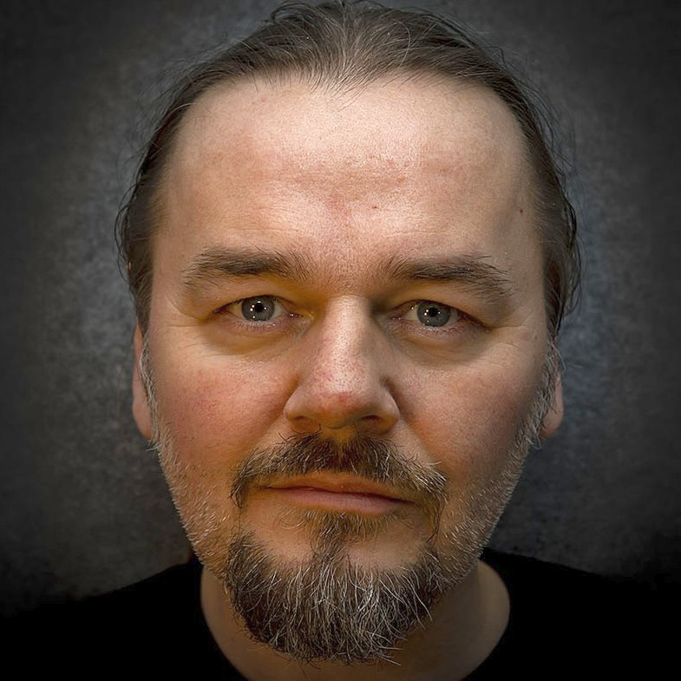
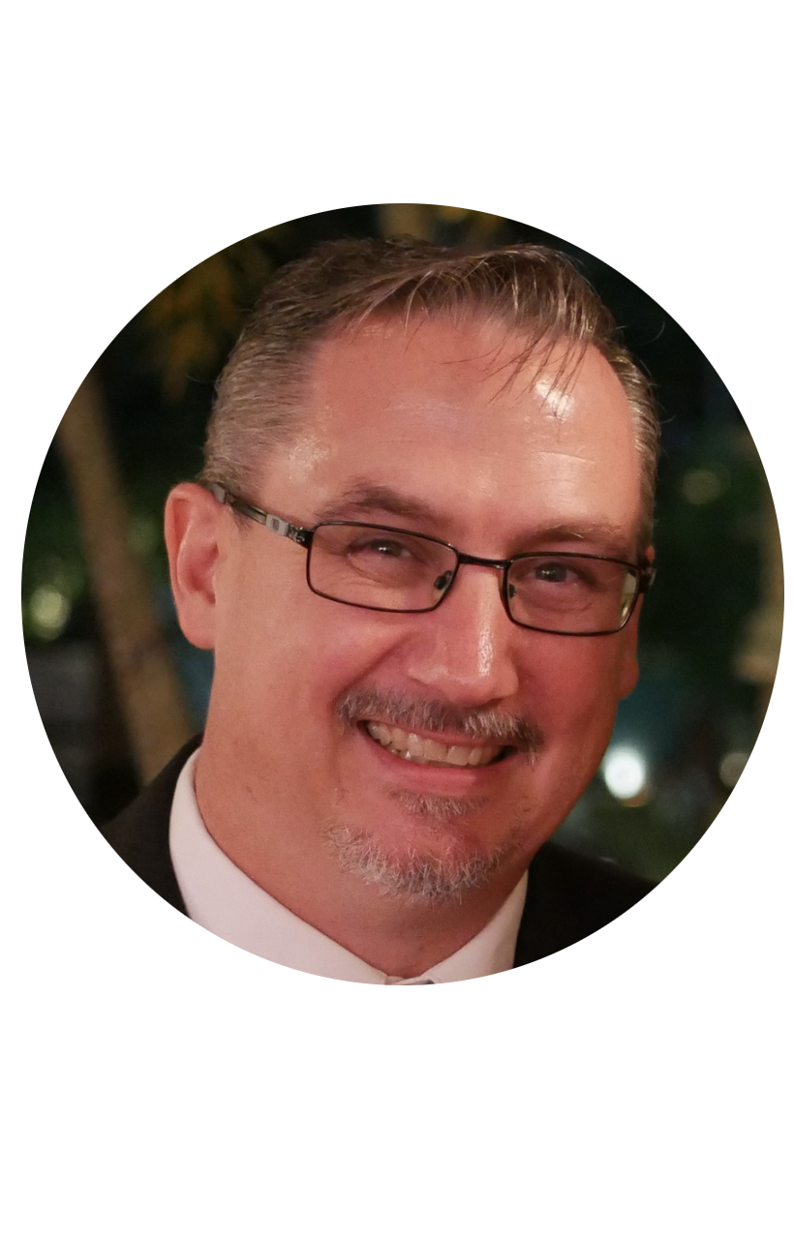

Introduction
BENGT GRONAS Senior Solutions Engineer 8 years in VMware Based in Oslo, Norway Covers 8 countries: Nordics and Baltics Often a Lab Captain at Vmware Explore / VMworld Music production, long travels; hiking, motorcycle, chess @bgronas
GREG SYLVESTRE Senior Solutions Engineer 11 years in VMware Based in Silicon Valley, California Covers: Salesforce and Meta (Facebook) 4th year in HOL (2013, 2014, 2021, 2022) Motorcycling, gaming rig builds and home repair projects @gsylvestre

Slide 2


Account information
HOL-2201-14-CMP student check-in – LET’S GO!!!
Name: holadmin
(VMware identity manager)
Password: VMware1!
Notes:
Now, let’s get to it
When we log in to the lab, we will be a Hands-On Lab Admin called holadmin, and the admin password will be Vmware One Bang!
So first of all let’s find

